Slide 1
Common Randomness Generation
T.S. Jayram (IBM Almaden)
Joint with Badih Ghazi (MIT)

Slide 2
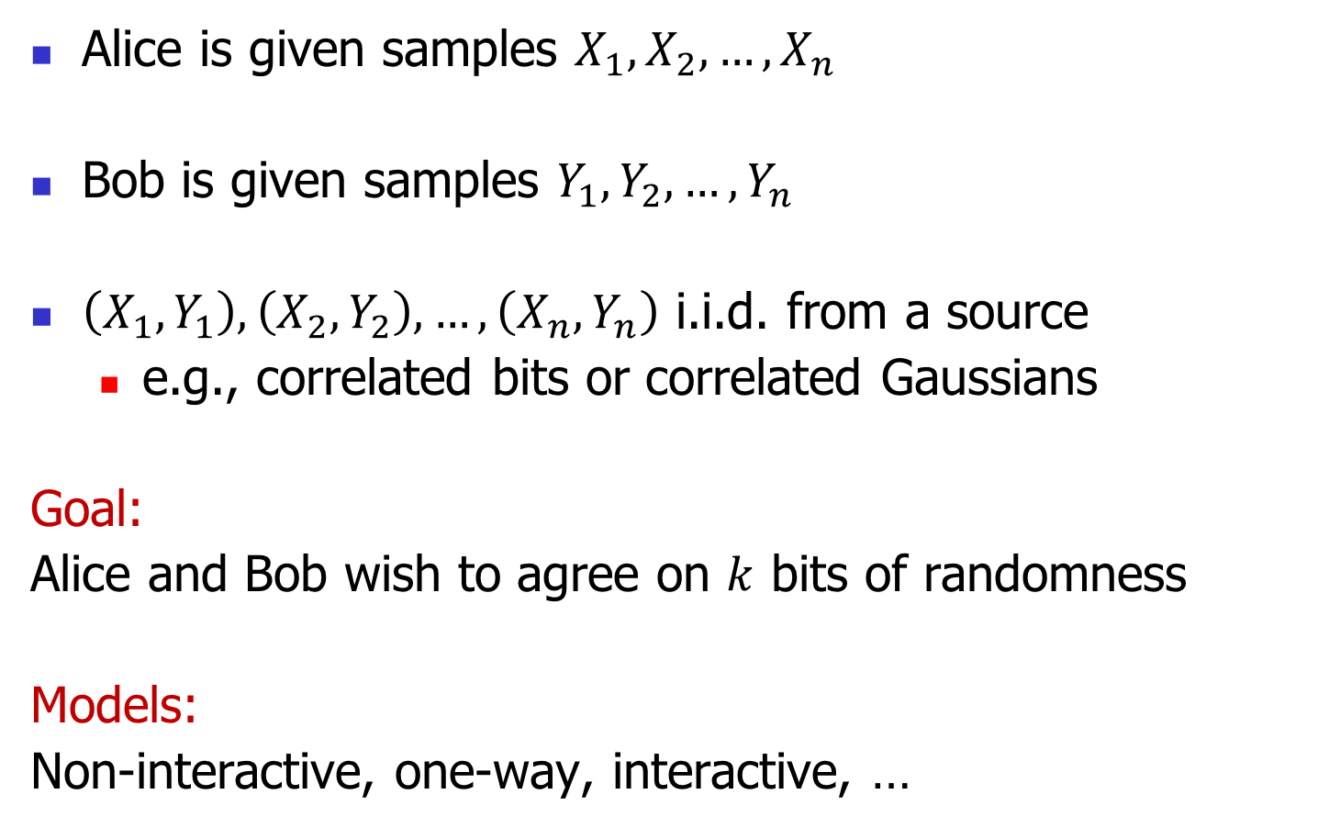
Common randomness (CR)
Alice is given samples $X_{1}, X_{2},…,X_{n}$
Bob is given samples $Y_{1},Y_{2},…,Y_{n}$
$\left(X_{1},Y_{1}\right),\left(X_{2},Y_{2}\right),…,\left(X_{n},Y_{n}\right)$ i.i.d. from a source
  e.g., correlated bits or correlated Gaussians
Goal:
Alice and Bob wish to agree on $k$ bits of randomness
Models:
Non-interactive, one-way, interactive, …

Slide 3



Simple Example
Consider the source of $ρ$-correlated bits $\left(X,Y\right)$
marginally uniform over $\left\{−1,+1\right\}$
$𝔼\left[XY\right]=ρ$, i.e., $\operatorname{Pr}\left[X=Y\right]=\frac{1+ρ}{2}$
-1
-1
$$\frac{1−ρ}{2}$$
+1
+1
$$\frac{1+ρ}{2}$$

Slide 4
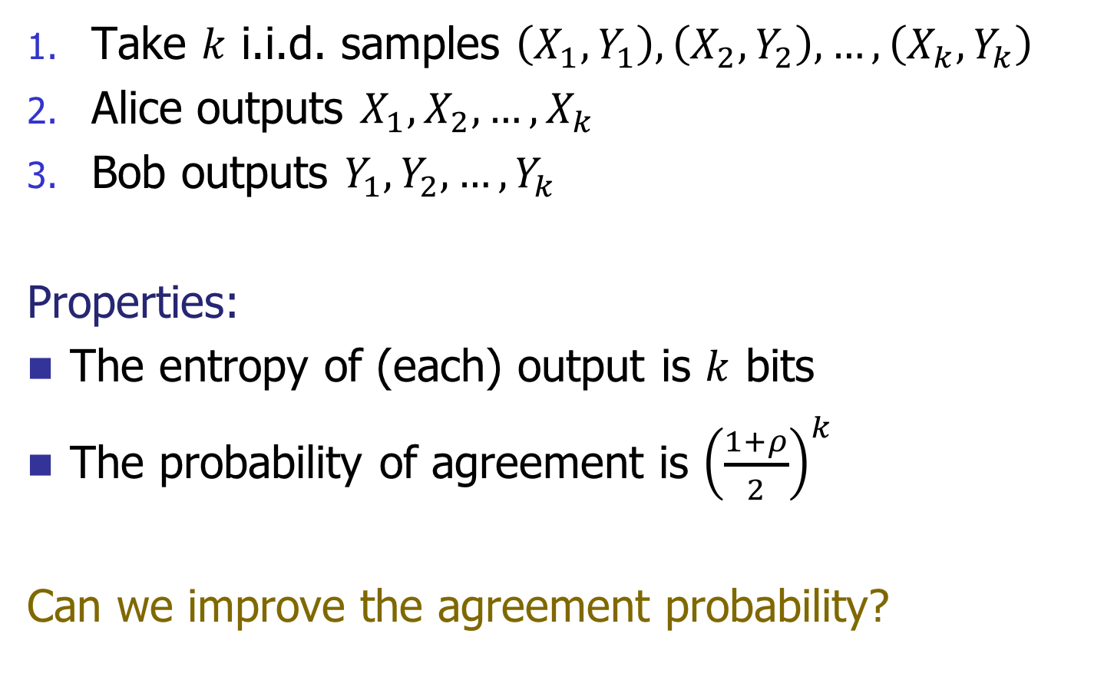
Non-interactive CR scheme
Take $k$ i.i.d. samples $\left(X_{1},Y_{1}\right),\left(X_{2},Y_{2}\right),…,\left(X_{k},Y_{k}\right)$
Alice outputs $X_{1}, X_{2},…,X_{k}$
Bob outputs $Y_{1}, Y_{2},…,Y_{k}$
Properties:
The entropy of (each) output is $k$ bits
The probability of agreement is ${{\left(\frac{1+ρ}{2}\right)}^{k}}^{ }$
Can we improve the agreement probability?

Slide 5
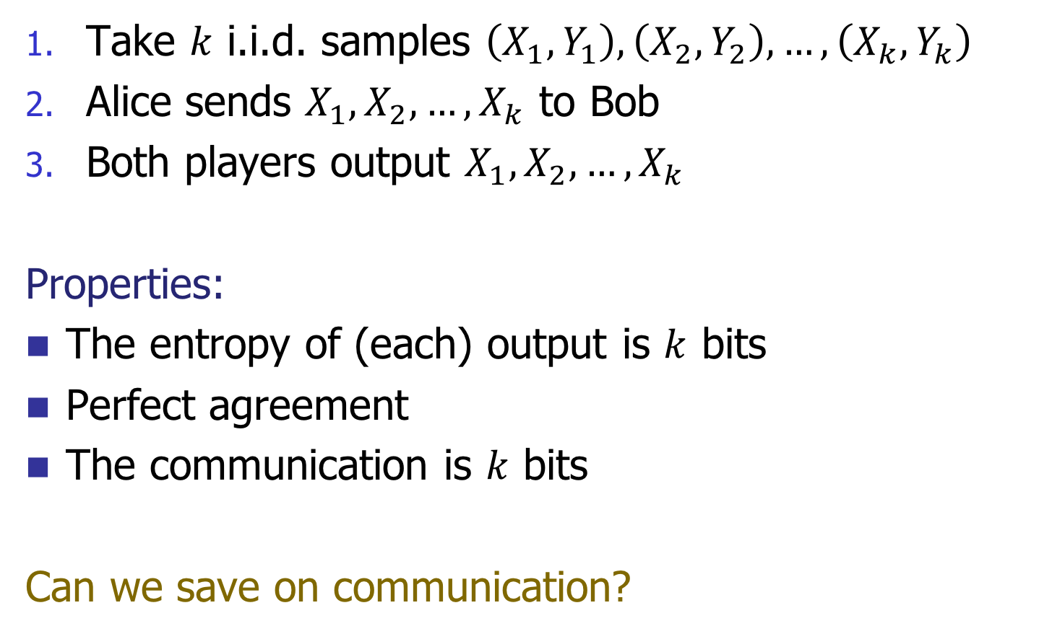
One-way CR scheme
Take $k$ i.i.d. samples $\left(X_{1},Y_{1}\right),\left(X_{2},Y_{2}\right),…,\left(X_{k},Y_{k}\right)$
Alice sends $X_{1}, X_{2},…,X_{k}$ to Bob
Both players output $X_{1}, X_{2},…,X_{k}$
Properties:
The entropy of (each) output is $k$ bits
Perfect agreement
The communication is $k$ bits
Can we save on communication?

Slide 6
History
Introduced by Ahlswede and Csiszár (1993,1998) for the one-way and 2-way interactive CR schemes.
  Information theory: [AC93, AC98, CN00, GK73, Wyn75, Tya13, LCV15, LCV16]
  TCS: [MO04, MOR+06, BM11, CMN14, CGMS14, GR16]
Secret Key Generation/Distillation problem in cryptography [Mau93, AC93, CN04, ZC11, Tya13]
Applications to communication with imperfect shared randomness [BGI14, CGMS14, GKS16]

Slide 7
Natural questions
Tradeoff between output entropy and agreement probability
Minimize number of samples
Explicit and/or computationally efficient schemes
Tradeoff between output entropy and communication

Slide 8
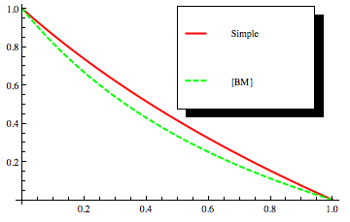
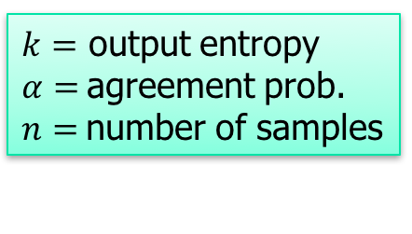
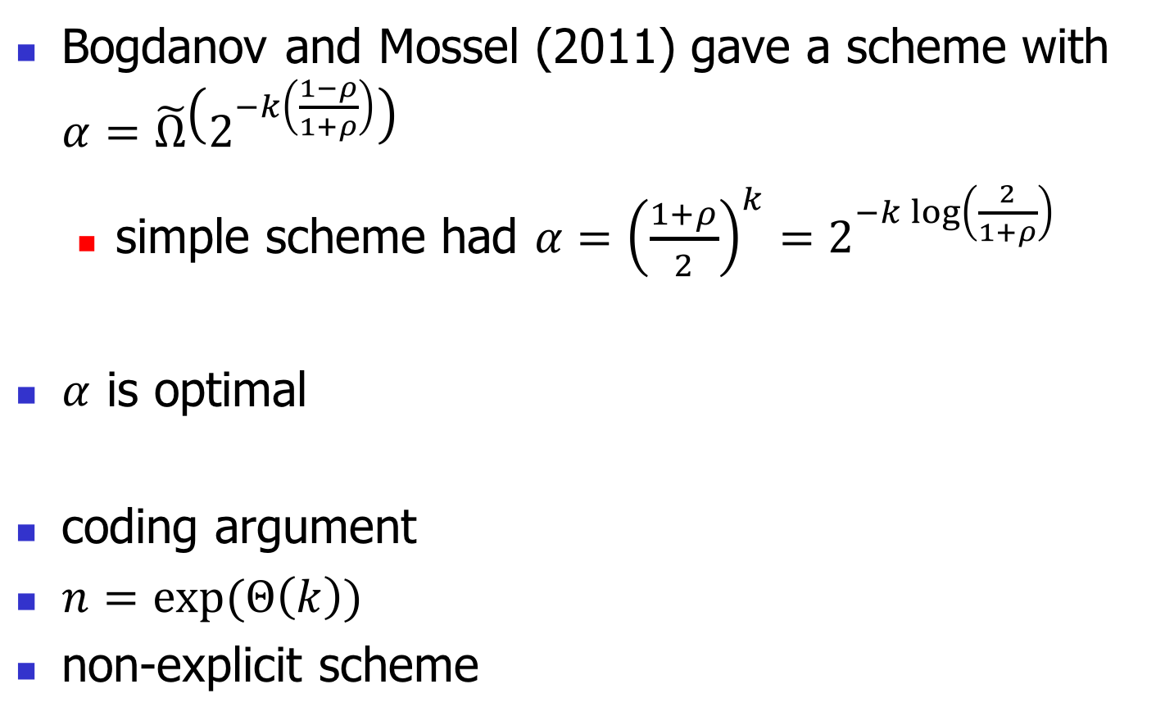
Non-interactive CR schemes
$k=$ output entropy
$α=$agreement prob.
$n=$number of samples
Bogdanov and Mossel (2011) gave a scheme with $α=\tilde{Ω}\left(2^{−k\left(\frac{1−ρ}{1+ρ}\right)}\right)$
  simple scheme had ${α={\left(\frac{1+ρ}{2}\right)}^{k}=2^{−k\log\left(\frac{2}{1+ρ}\right)}}^{ }$
$α$ is optimal
coding argument
$n=\exp{(Θ\left(k\right))}$
non-explicit scheme

Slide 9
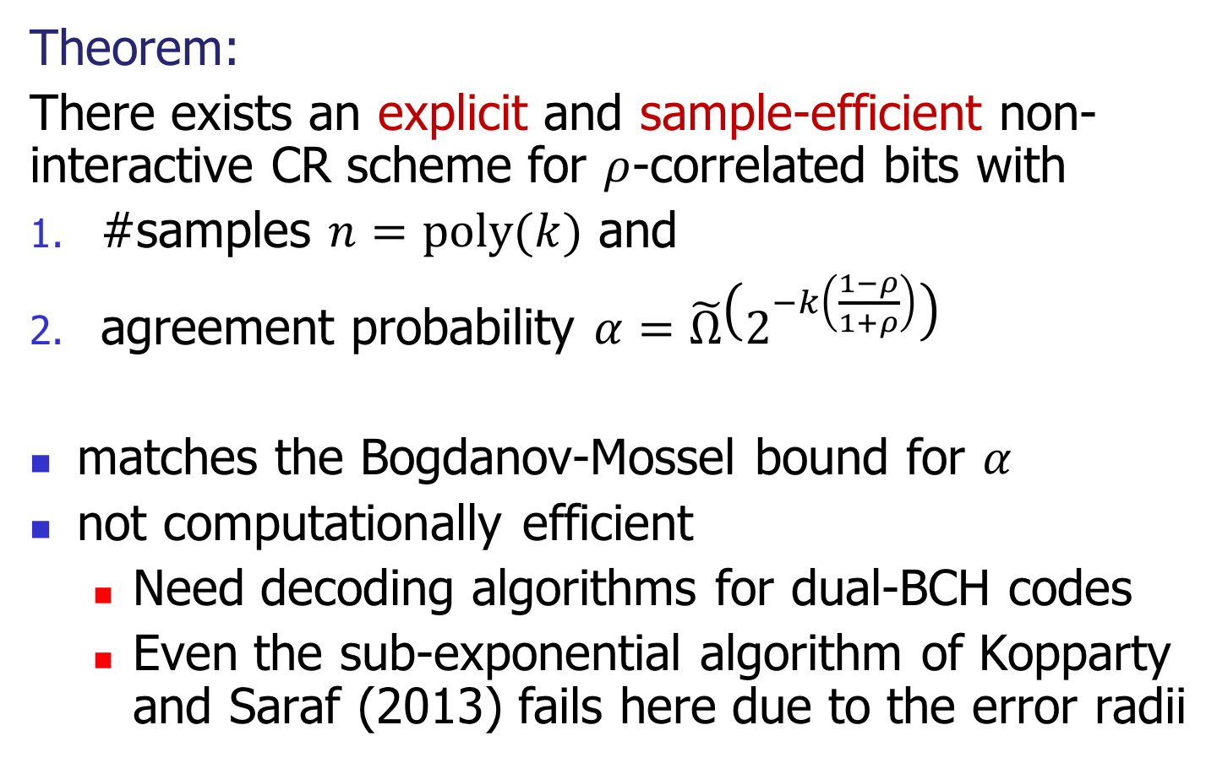
Our result
$k=$ output entropy
$α=$agreement prob.
$n=$number of samples
Theorem:
There exists an explicit and sample-efficient non-interactive CR scheme for $ρ$-correlated bits with
#samples $n=\operatorname{poly}{(k)}$ and
agreement probability $α=\tilde{Ω}\left(2^{−k\left(\frac{1−ρ}{1+ρ}\right)}\right)$
matches the Bogdanov-Mossel bound for $α$
not computationally efficient
  Need decoding algorithms for dual-BCH codes
  Even the sub-exponential algorithm of Kopparty and Saraf (2013) fails here due to the error radii

Slide 10
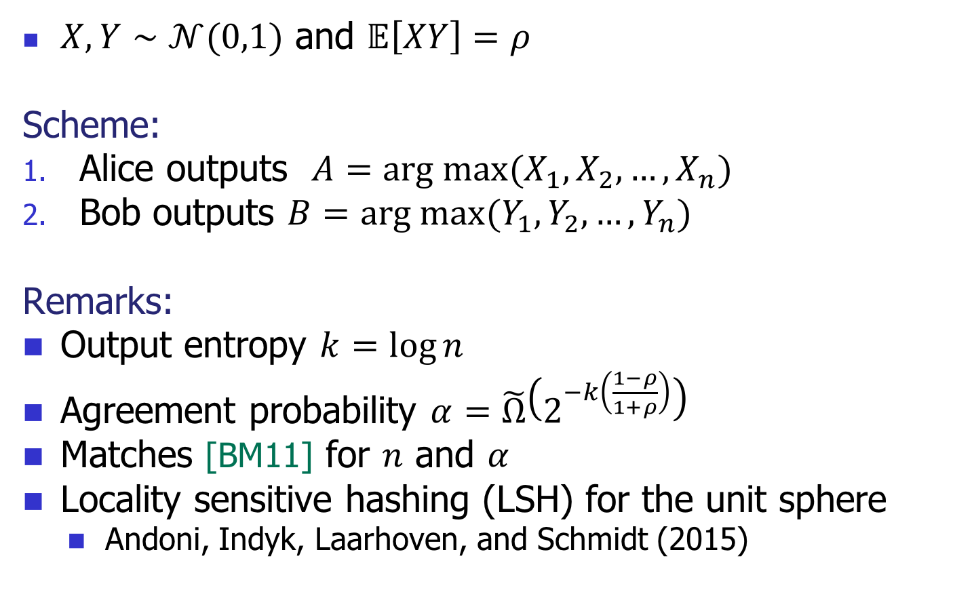
Correlated Gaussians
$k=$ output entropy
$α=$agreement prob.
$n=$number of samples
$X,Y∼𝒩(0,1)$ and $𝔼\left[XY\right]=ρ$
Scheme:
Alice outputs $A=arg max{(X_{1},X_{2},…,}X_{n})$
Bob outputs $B=arg max{(Y_{1},Y_{2},…,}Y_{n})$
Remarks:
Output entropy $k=\log{n}$
  Agreement probability $α=\tilde{Ω}\left(2^{−k\left(\frac{1−ρ}{1+ρ}\right)}\right)$
  Matches [BM11] for $n$ and $α$
  Locality sensitive hashing (LSH) for the unit sphere
    Andoni, Indyk, Laarhoven, and Schmidt (2015)

Slide 11
Reducing the number of samples (I)
Analysis depends only on the pairwise independence of the coordinate samples
Generate the samples using multivariate Gaussians that are pairwise independent
Pairwise independence implies full independence for the multivariate Gaussian distribution 😞

Slide 12
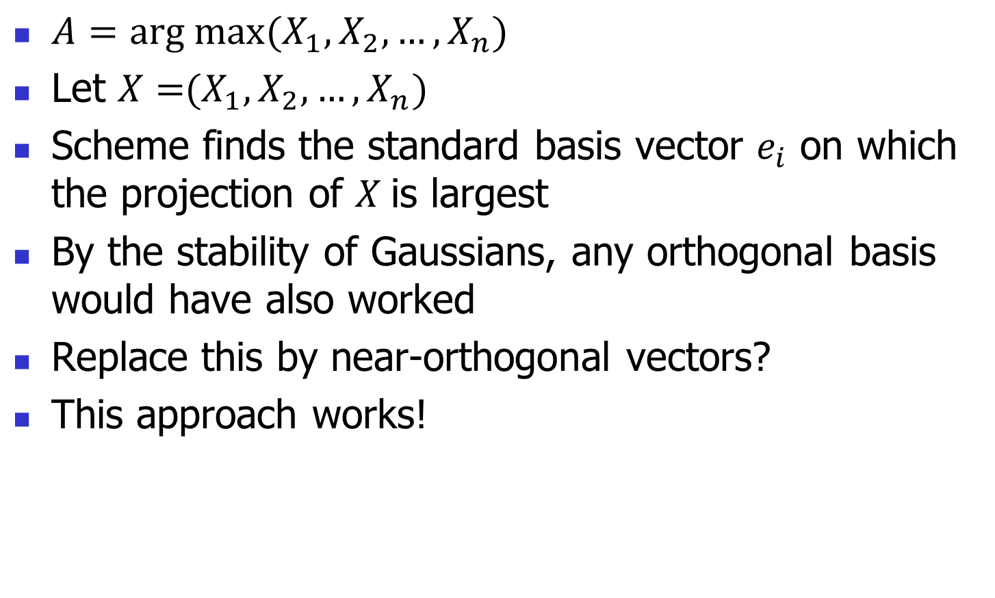
Reducing the number of samples (II)
$A=arg max{(X_{1},X_{2},…,}X_{n})$
Let $X={(X_{1},X_{2},…,}X_{n})$
Scheme finds the standard basis vector $e_{i}$ on which the projection of $X$is largest
By the stability of Gaussians, any orthogonal basis would have also worked
Replace this by near-orthogonal vectors?
This approach works!

Slide 13
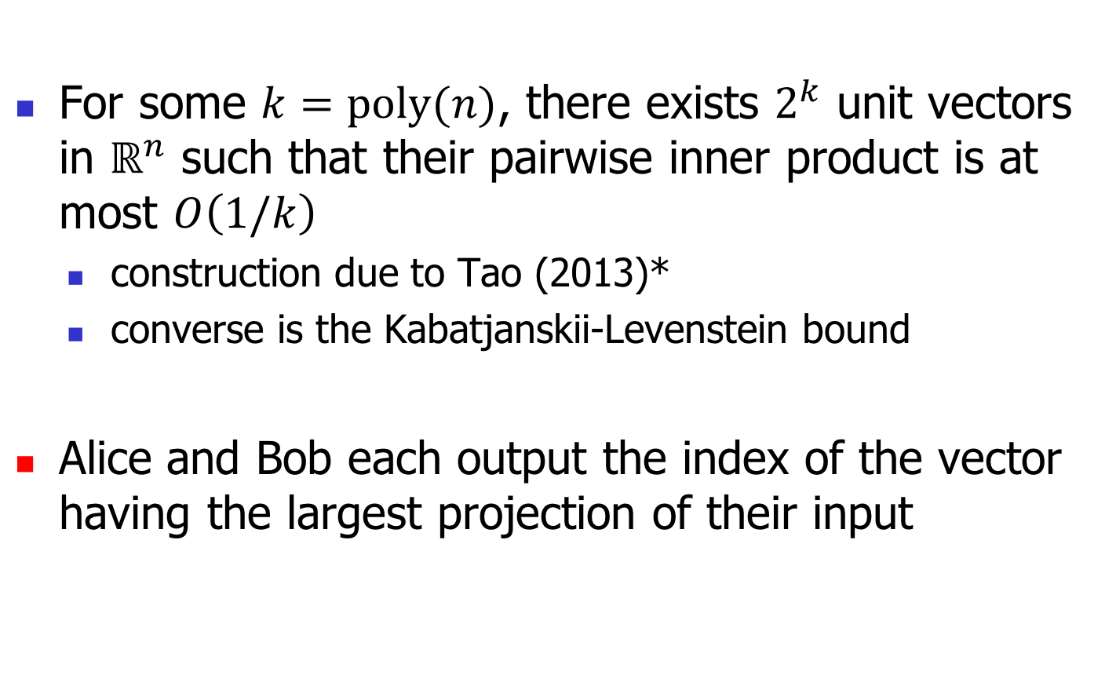
Sample efficient scheme
$k=$ output entropy
$α=$agreement prob.
$n=$number of samples
  For some $k=\operatorname{poly}{(n)}$, there exists $2^{k}$ unit vectors in $ℝ^{n}$ such that their pairwise inner product is at most $O\left(1/k\right)$
    construction due to Tao (2013)*
    converse is the Kabatjanskii-Levenstein bound
  Alice and Bob each output the index of the vector having the largest projection of their input

Slide 14





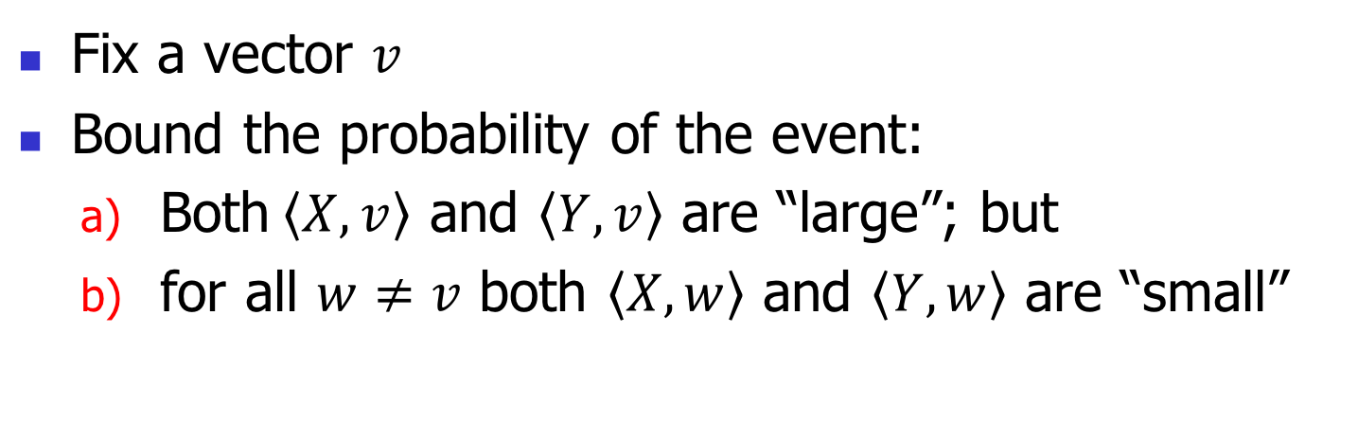
Analysis of agreement probability
$$X$$
$$w_{1}$$
$$v$$
$$w_{2}$$
$$Y$$
Bivariate Gaussian tail probability
Fix a vector $v$
Bound the probability of the event:
  Both$\left\langle X,v\right\rangle$ and $\left\langle Y,v\right\rangle$ are “large”; but
  for all $w≠v$ both $\left\langle X,w\right\rangle$ and $\left\langle Y,w\right\rangle$ are “small”
Trivariate Gaussian tail probability

Slide 15
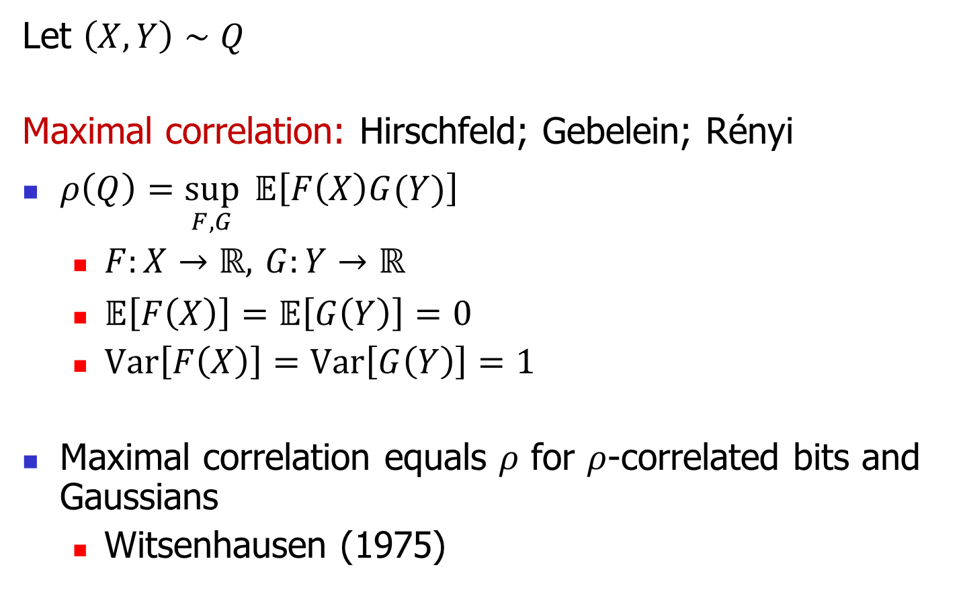
Arbitrary sources: maximal correlation
Let $\left(X,Y\right)∼Q$
Maximal correlation: Hirschfeld; Gebelein; Rényi
$ρ\left(Q\right)=\sup_{F,G}{ 𝔼\left[F\left(X\right)G(Y)\right]}$
  $F:X→ℝ,$ $G:Y→ℝ$
  $𝔼\left[F\left(X\right)\right]=𝔼\left[G\left(Y\right)\right]=0$
  $Var\left[F\left(X\right)\right]=Var\left[G\left(Y\right)\right]=1$
Maximal correlation equals $ρ$ for $ρ$-correlated bits and Gaussians
  Witsenhausen (1975)

Slide 16
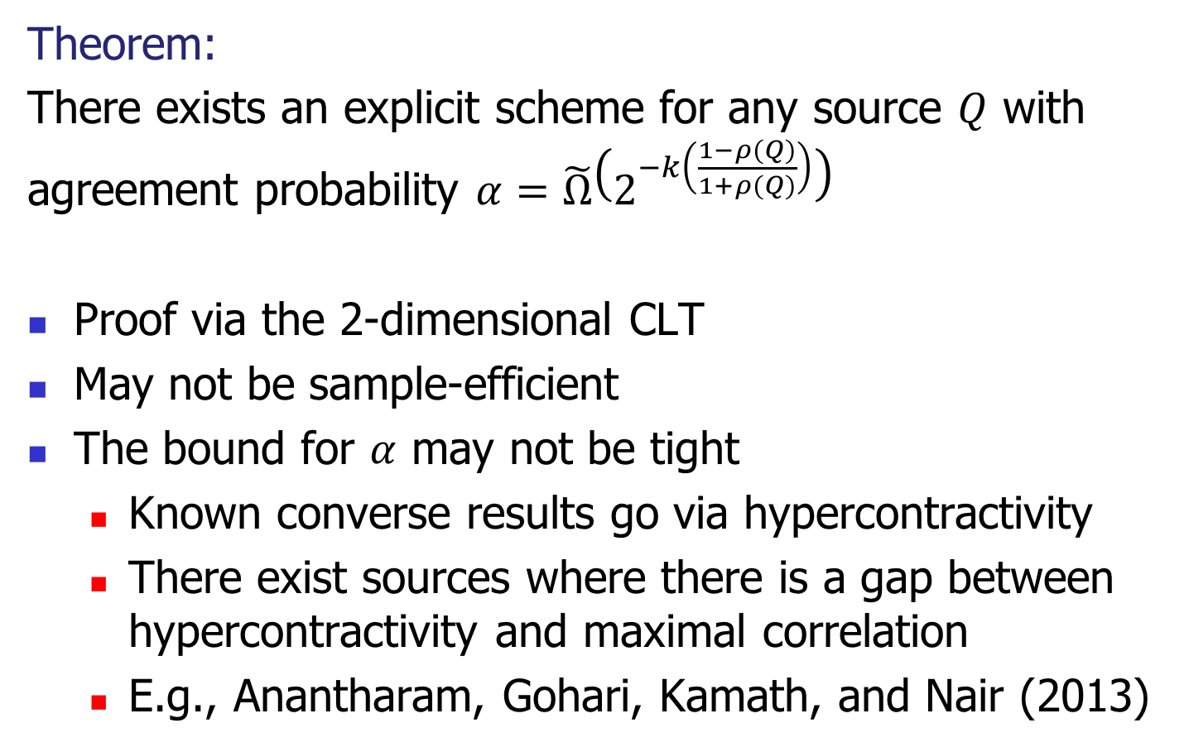
CR for arbitrary sources
$k=$ output entropy
$α=$agreement prob.
$n=$number of samples
Theorem:
There exists an explicit scheme for any source $Q$ with agreement probability $α=\tilde{Ω}\left(2^{−k\left(\frac{1−ρ(Q)}{1+ρ(Q)}\right)}\right)$
Proof via the 2-dimensional CLT
May not be sample-efficient
The bound for $α$ may not be tight
  Known converse results go via hypercontractivity
  There exist sources where there is a gap between hypercontractivity and maximal correlation
  E.g., Anantharam, Gohari, Kamath, and Nair (2013)

Slide 17
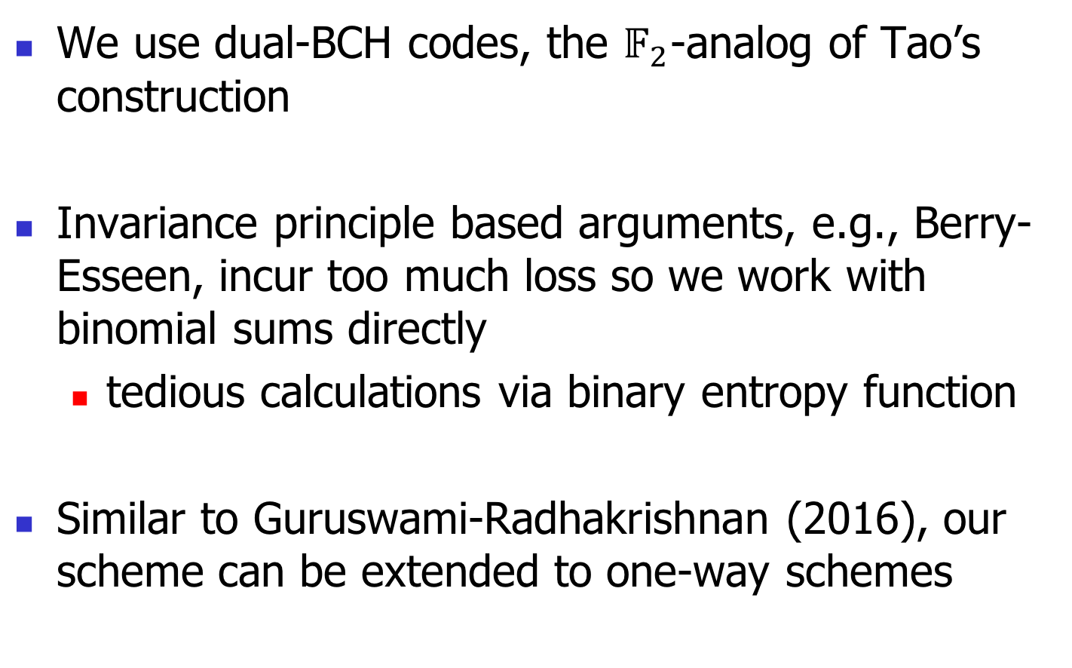
Correlated bits
  We use dual-BCH codes, the $𝔽_{2}$-analog of Tao’s construction
Invariance principle based arguments, e.g., Berry-Esseen, incur too much loss so we work with binomial sums directly
  tedious calculations via binary entropy function
Similar to Guruswami-Radhakrishnan (2016), our scheme can be extended to one-way schemes

Slide 18
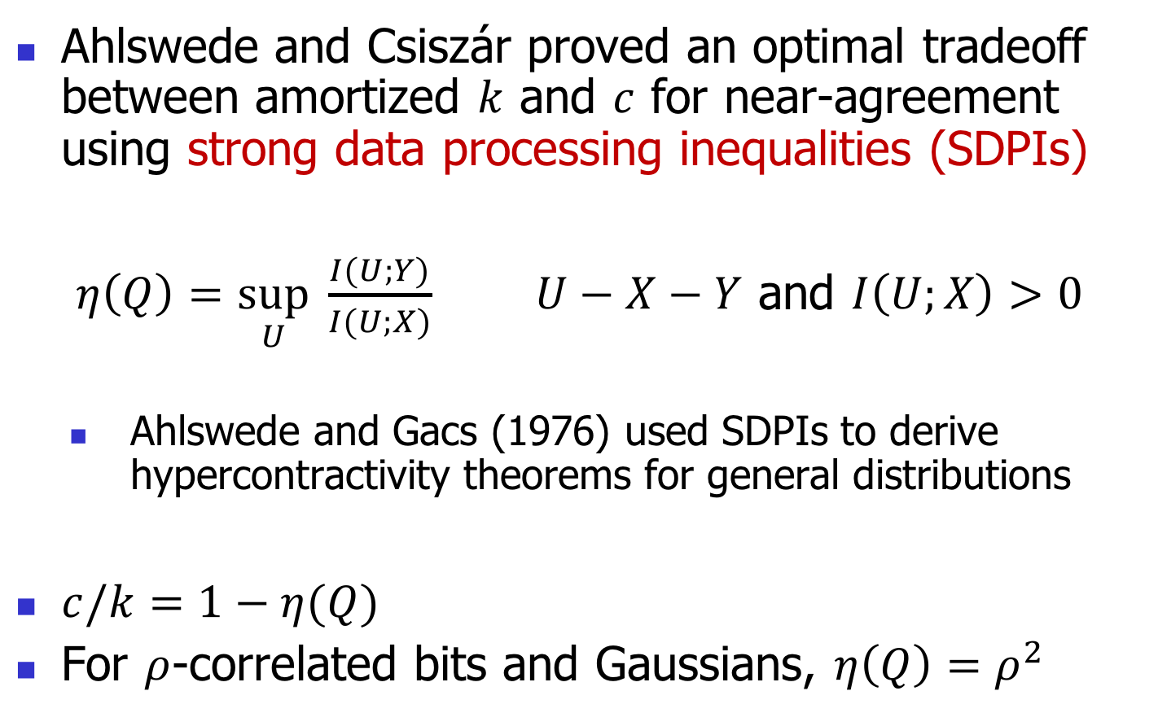
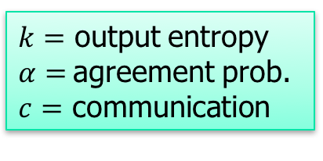
One-way schemes
$k=$ output entropy
$α=$agreement prob.
$c=$ communication
Ahlswede and Csiszár proved an optimal tradeoff between amortized $k$ and $c$ for near-agreement using strong data processing inequalities (SDPIs)
$η\left(Q\right)=\sup_{U}{ \frac{I(U;Y)}{I(U;X)}}$ $U−X−Y$ and $I\left(U;X\right)>0$
    Ahlswede and Gacs (1976) used SDPIs to derive hypercontractivity theorems for general distributions
$c/k=1−η(Q)$
For $ρ$-correlated bits and Gaussians, $η\left(Q\right)=ρ^{2}$

Slide 19
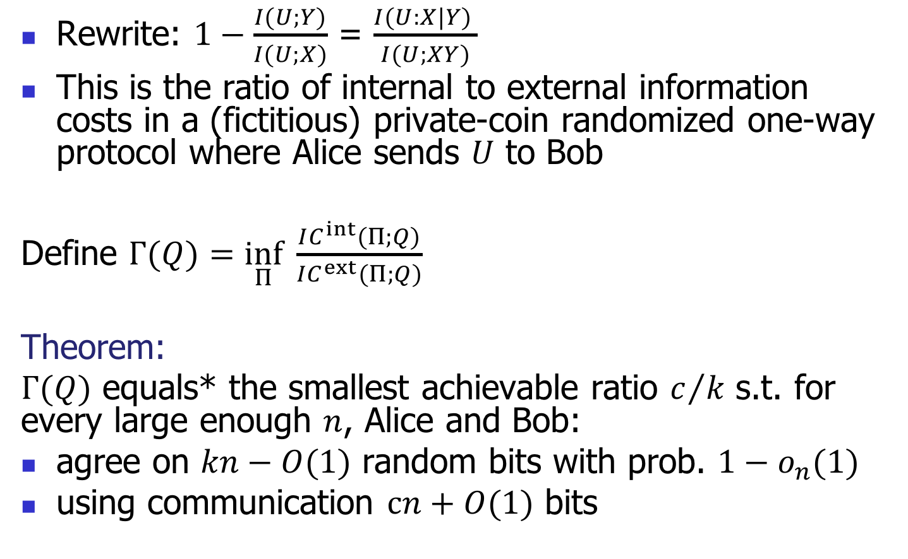
Relationship to information cost
Rewrite: $1−\frac{I(U;Y)}{I(U;X)}$ = $\frac{I(U:X|Y) }{I(U;XY)}$
This is the ratio of internal to external information costs in a (fictitious) private-coin randomized one-way protocol where Alice sends $U$ to Bob
Define $Γ(Q)=\inf_{Π}{ \frac{IC^{int}(Π;Q)}{IC^{ext}(Π;Q)}}$
Theorem:
$Γ(Q)$ equals* the smallest achievable ratio $c/k$ s.t. for every large enough $n$, Alice and Bob:
agree on $kn−O(1)$ random bits with prob. $1−o_{n}(1)$
using communication $cn+O(1)$ bits

Slide 20
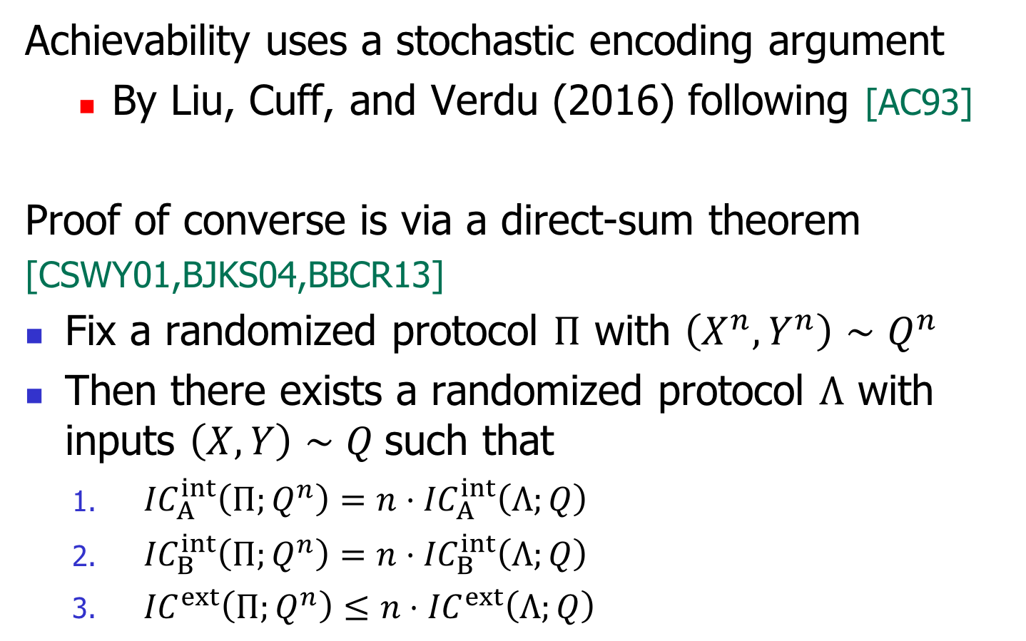
Common randomness vs information cost
Achievability uses a stochastic encoding argument
  By Liu, Cuff, and Verdu (2016) following [AC93]
Proof of converse is via a direct-sum theorem
[CSWY01,BJKS04,BBCR13]
Fix a randomized protocol $Π$ with $\left(X^{n},Y^{n}\right)∼Q^{n}$
  Then there exists a randomized protocol $Λ$ with inputs $\left(X,Y\right)∼Q$such that
    ${IC}_{A}^{int}\left(Π;Q^{n}\right)=n⋅{IC}_{A}^{int}\left(Λ;Q\right)$
    ${IC}_{B}^{int}\left(Π;Q^{n}\right)=n⋅{IC}_{B}^{int}\left(Λ;Q\right)$
    ${IC}^{ext}\left(Π;Q^{n}\right)≤n⋅{IC}^{ext}\left(Λ;Q\right)$

Slide 21
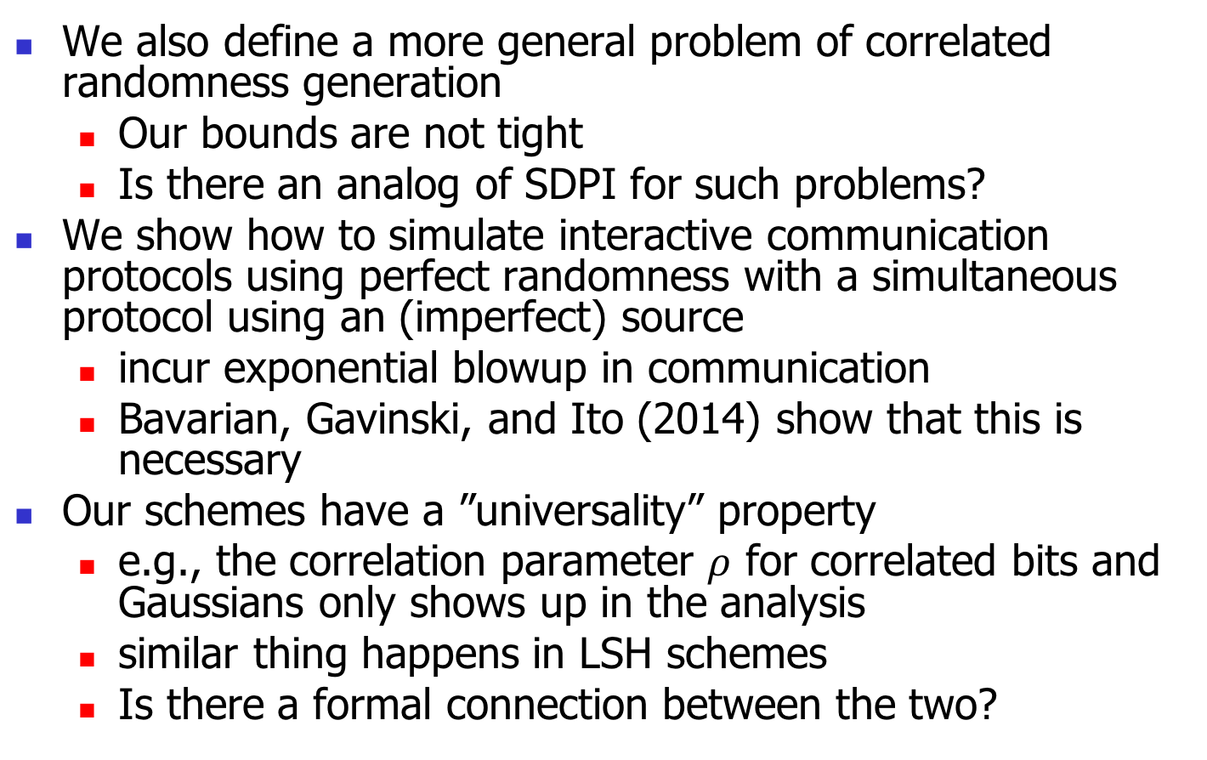
Other Results + Conclusion
We also define a more general problem of correlated randomness generation
  Our bounds are not tight
  Is there an analog of SDPI for such problems?
We show how to simulate interactive communication protocols using perfect randomness with a simultaneous protocol using an (imperfect) source
  incur exponential blowup in communication
  Bavarian, Gavinski, and Ito (2014) show that this is necessary
Our schemes have a ”universality” property
  e.g., the correlation parameter $ρ$ for correlated bits and Gaussians only shows up in the analysis
  similar thing happens in LSH schemes
  Is there a formal connection between the two?

